Slide 1
Luke 24:1-35
1On the first day of the week, very early in the morning, the women took the spices they had prepared and went to the tomb. 2 They found the stone rolled away from the tomb, 3 but when they entered, they did not find the body of the Lord Jesus. 4 While they were wondering about this, suddenly two men in clothes that gleamed like lightning stood beside them. 5 In their fright the women bowed down with their faces to the ground, but the men said to them, "Why do you look for the living among the dead?

Slide 2
Luke 24:1-35
6 He is not here; he has risen! Remember how he told you, while he was still with you in Galilee: 7 'The Son of Man must be delivered into the hands of sinful men, be crucified and on the third day be raised again.' " 8 Then they remembered his words. 9 When they came back from the tomb, they told all these things to the Eleven and to all the others. 10It was Mary Magdalene, Joanna, Mary the mother of James, and the others with them who told this to the apostles. 11But they did not believe the women, because their words seemed to them like nonsense.

Slide 3
Luke 24:1-35
12Peter, however, got up and ran to the tomb. Bending over, he saw the strips of linen lying by themselves, and he went away, wondering to himself what had happened. 13Now that same day two of them were going to a village called Emmaus, about seven miles from Jerusalem. 14They were talking with each other about everything that had happened. 15As they talked and discussed these things with each other, Jesus himself came up and walked along with them; 16but they were kept from recognizing him.

Slide 4
Luke 24:1-35
17He asked them, "What are you discussing together as you walk along?" 18They stood still, their faces downcast. One of them, named Cleopas, asked him, "Are you only a visitor to Jerusalem and do not know the things that have happened there in these days?" 19"What things?" he asked. 20"About Jesus of Nazareth," they replied. "He was a prophet, powerful in word and deed before God and all the people. The chief priests and our rulers handed him over to be sentenced to death, and they crucified him;

Slide 5
Luke 24:1-35
21but we had hoped that he was the one who was going to redeem Israel. And what is more, it is the third day since all this took place. 22In addition, some of our women amazed us. They went to the tomb early this morning 23but didn't find his body. They came and told us that they had seen a vision of angels, who said he was alive. 24Then some of our companions went to the tomb and found it just as the women had said, but him they did not see." 25He said to them, "How foolish you are, and how slow of heart to believe all that the prophets have spoken!

Slide 6
Luke 24:1-35
26Did not the Christ have to suffer these things and then enter his glory?" 27And beginning with Moses and all the Prophets, he explained to them what was said in all the Scriptures concerning himself. 28As they approached the village to which they were going, Jesus acted as if he were going farther. 29But they urged him strongly, "Stay with us, for it is nearly evening; the day is almost over." So he went in to stay with them. 30When he was at the table with them, he took bread, gave thanks, broke it and began to give it to them.

Slide 7
Luke 24:1-35
31Then their eyes were opened and they recognized him, and he disappeared from their sight. 32They asked each other, "Were not our hearts burning within us while he talked with us on the road and opened the Scriptures to us?" 33They got up and returned at once to Jerusalem. There they found the Eleven and those with them, assembled together 34and saying, "It is true! The Lord has risen and has appeared to Simon." 35Then the two told what had happened on the way, and how Jesus was recognized by them when he broke the bread.

Slide 8
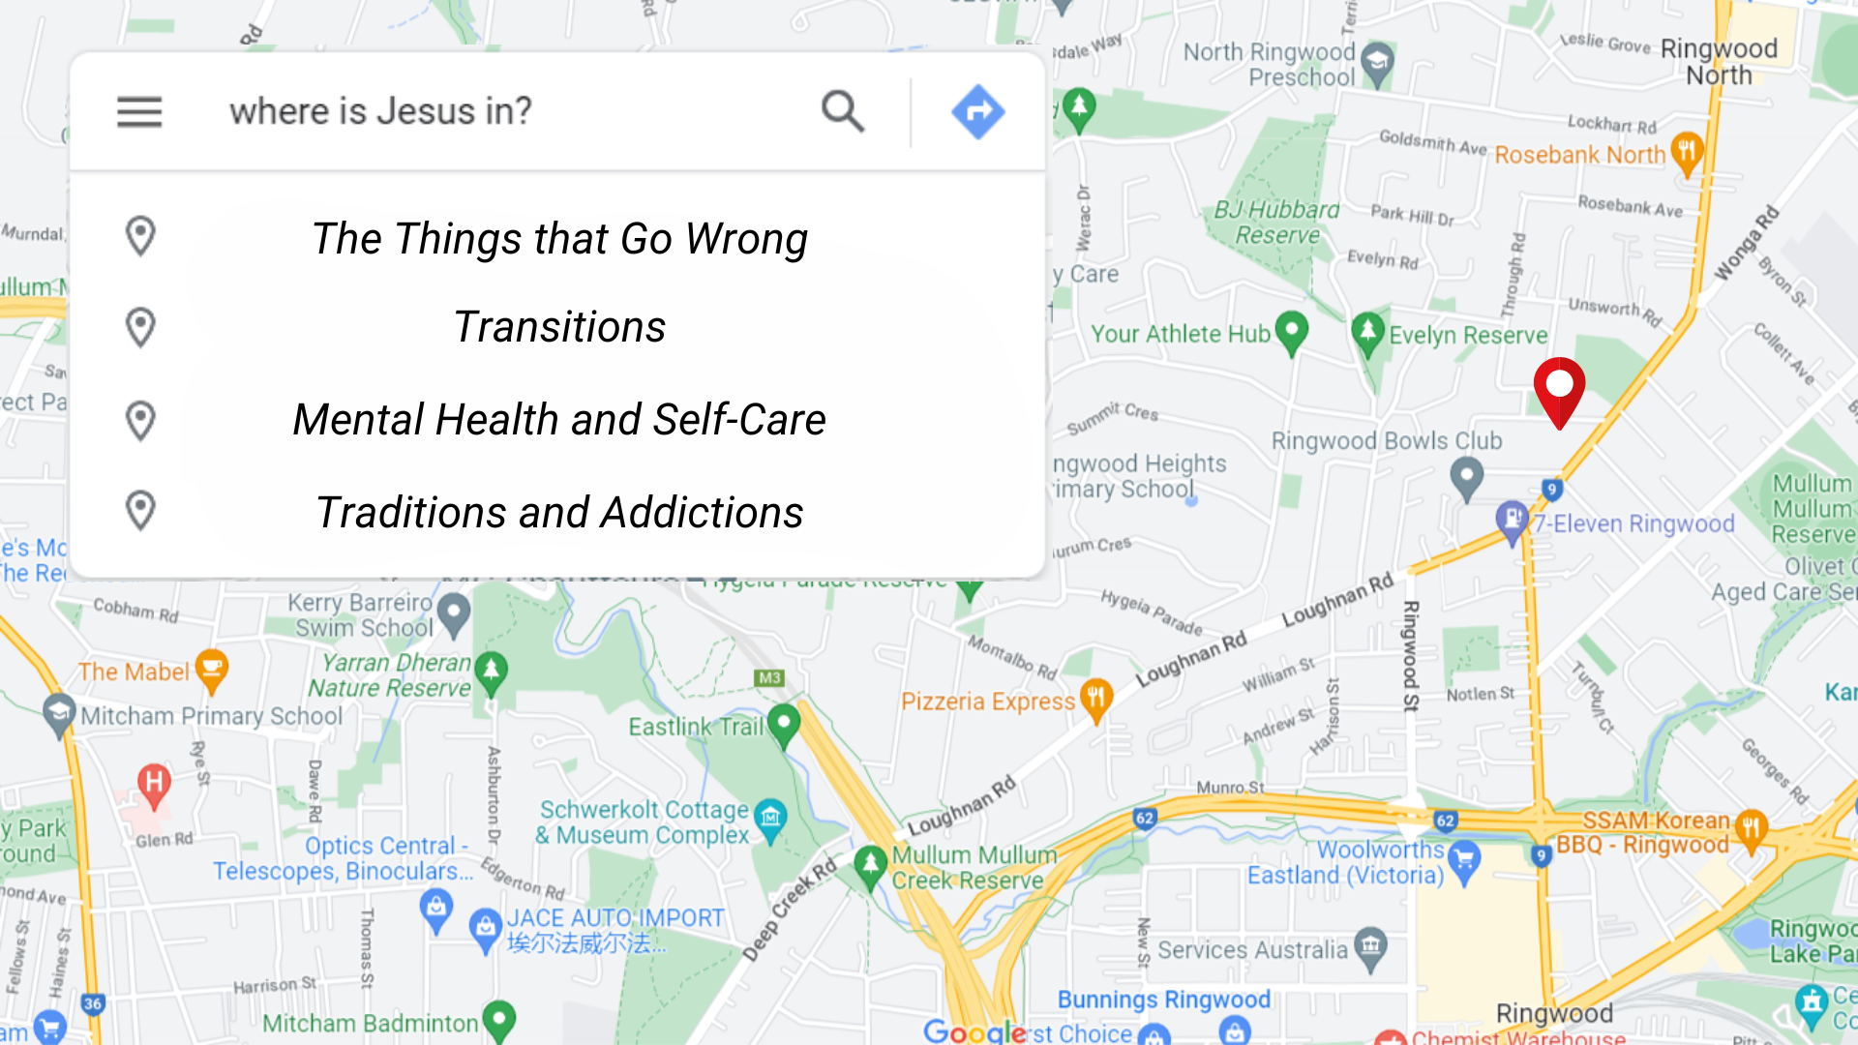

Slide 9
Luke 24:1-35
24 On the first day of the week, very early in the morning, the women took the spices they had prepared and went to the tomb. ² They found the stone rolled away from the tomb, ³ but when they entered, they did not find the body of the Lord Jesus. ⁴ While they were wondering about this, suddenly two men in clothes that gleamed like lightning stood beside them. ⁵ In their fright the women bowed down with their faces to the ground, but the men said to them, “Why do you look for the living among the dead?

Slide 10
Luke 24:1-35
⁶ He is not here; he has risen! Remember how he told you, while he was still with you in Galilee: ⁷ ‘The Son of Man must be delivered over to the hands of sinners, be crucified and on the third day be raised again.’ ” ⁸ Then they remembered his words.
⁹ When they came back from the tomb, they told all these things to the Eleven and to all the others. ¹⁰ It was Mary Magdalene, Joanna, Mary the mother of James, and the others with them who told this to the apostles.

Slide 11
Luke 24:1-35
¹¹ But they did not believe the women, because their words seemed to them like nonsense. ¹² Peter, however, got up and ran to the tomb. Bending over, he saw the strips of linen lying by themselves, and he went away, wondering to himself what had happened.
On the Road to Emmaus
¹³ Now that same day two of them were going to a village called Emmaus, about seven miles^{[a]} from Jerusalem. ¹⁴ They were talking with each other about everything that had happened.

Slide 12
Luke 24:1-35
¹⁵ As they talked and discussed these things with each other, Jesus himself came up and walked along with them; ¹⁶ but they were kept from recognizing him.
¹⁷ He asked them, “What are you discussing together as you walk along?”
They stood still, their faces downcast. ¹⁸ One of them, named Cleopas, asked him, “Are you the only one visiting Jerusalem who does not know the things that have happened there in these days?”

Slide 13
Luke 24:1-35
¹⁹ “What things?” he asked.
“About Jesus of Nazareth,” they replied. “He was a prophet, powerful in word and deed before God and all the people. ²⁰ The chief priests and our rulers handed him over to be sentenced to death, and they crucified him; ²¹ but we had hoped that he was the one who was going to redeem Israel. And what is more, it is the third day since all this took place. ²² In addition, some of our women amazed us. They went to the tomb early this morning

Slide 14
Luke 24:1-35
²³ but didn’t find his body. They came and told us that they had seen a vision of angels, who said he was alive. ²⁴ Then some of our companions went to the tomb and found it just as the women had said, but they did not see Jesus.”
²⁵ He said to them, “How foolish you are, and how slow to believe all that the prophets have spoken! ²⁶ Did not the Messiah have to suffer these things and then enter his glory?” ²⁷ And beginning with Moses and all the Prophets, he explained to them what was said in all the Scriptures concerning himself.

Slide 15
Luke 24:1-35
²⁸ As they approached the village to which they were going, Jesus continued on as if he were going farther. ²⁹ But they urged him strongly, “Stay with us, for it is nearly evening; the day is almost over.” So he went in to stay with them.
³⁰ When he was at the table with them, he took bread, gave thanks, broke it and began to give it to them. ³¹ Then their eyes were opened and they recognized him, and he disappeared from their sight. ³² They asked each other, “Were not our hearts burning within us while he talked with us on the road and opened the Scriptures to us?”

Slide 16
Luke 24:1-35
³³ They got up and returned at once to Jerusalem. There they found the Eleven and those with them, assembled together ³⁴ and saying, “It is true! The Lord has risen and has appeared to Simon.” ³⁵ Then the two told what had happened on the way, and how Jesus was recognized by them when he broke the bread.

Slide 17
The Context
Jesus is risen, the stone has been rolled away
The female disciples of Christ have found the tomb empty, they have shared their report
Peter has confirmed it but no one understands what is going on other than the women who the angels have explained it to.

Slide 18
The Road to Emmaus
We meet two disciples
  They have had arguably the worst few days of their lives
  They are confused, and hurt.
  They cant stop discussing it.

Slide 19
The Road to Emmaus
Jesus comes alongside them and asks what they are talking about?
  He already painfully is aware of what has occurred and what they are talking about.
They stop, they stand still and they vent everything that has been going on.

Slide 20
The Road to Emmaus
Jesus responds
  He teaches them all about it
  He shows them the truth

Slide 21
The Road to Emmaus
They arrive, and they invite Jesus to share in a meal together, a very intimate thing to do in Jewish culture.

Slide 22
The Four points
1. Jesus walks alongside us inviting us to talk with him
2. They stopped, they stilled themselves and they shared with God.

Slide 23
The Road to Emmaus
3. Jesus speaks back into our lives, that there is a greater purpose and our sight may need adjusting
4. the disciples invited Jesus into intimate fellowship and finally their perception was adjust they saw the truth

Slide 24
The Questions to ask
1. Have you accepted Jesus’ invitation to bring him into the conversation?
2. Have you stilled yourself, and allowed the pain to flow out of you to him?
3. Have you stopped to listen and learn?
4. Have you invited Jesus to keep fellowship with you in the same way you would invite someone to share a meal with you?

